Slide 1

Rechnerarchitekturen für Deep-Learning Anwendungen (RADL)
Dustin Heither, Maximilian Achenbach and Robert Kagan
Optimizing Deep Learning Performance:
A Hybrid CPU-GPU Framework with Multithreading, SIMD,
and Evaluation of Efficiency Metrics

Slide 2
Outline
Presentation
01
TensorFlow
02
Input/output
03
C implementation
04
Hardware
05
Benchmark
06
Outlook

Slide 3
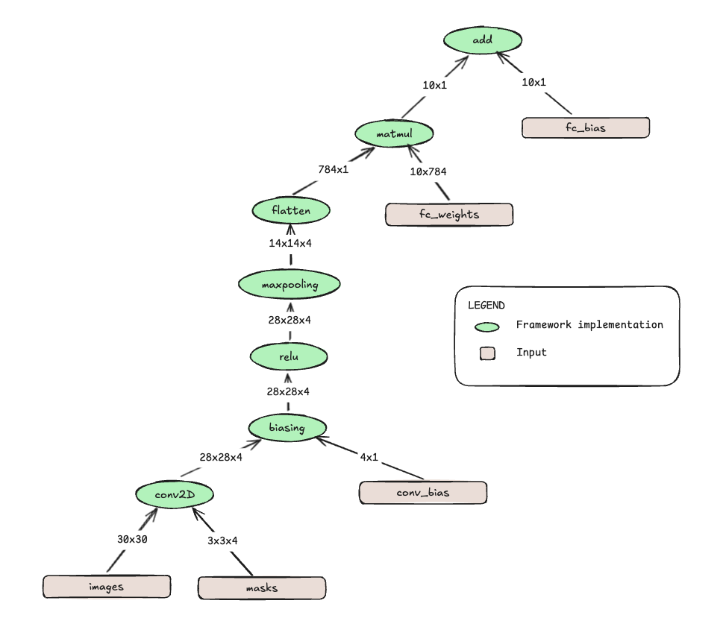

TensorFlow
1 / 4
#!/usr/bin/env python
import tensorflow # type: ignore
import tensorflow_datasets as tfds # type: ignore
import numpy as np # type: ignore
import os
# https://www.tensorflow.org/datasets/keras_example
tf = tensorflow.compat.v1
# disable eager execution
tf.disable_eager_execution()
# download dataset and store reference in variable
(train_ds, test_ds), ds_info = tfds.load(
'mnist',
split=['train', 'test'],
shuffle_files=True,
as_supervised=True,
with_info=True,
)
# normalizes images
def normalize_img(image, label):
"""Normalizes images: `uint8` -> `float32`."""
return tf.cast(image, tf.float32) / 255.0, label
# tfds provide images of type 'tf.uint8', while the model expects 'tf.float32', therefore, you need to normalize images
train_ds = train_ds.map(normalize_img, num_parallel_calls=tf.data.AUTOTUNE)
# reshape datasets to 28 x 28 x 1 pixels (height x width x color channels)
train_ds = train_ds.map(lambda image, label: (tf.reshape(image, [28, 28, 1]), label))
# pad images with 1 row/column of pixels on each side for 3 x 3 filter (border handling)
train_ds = train_ds.map(lambda image, label: (tf.pad(image, [[1, 1], [1, 1], [0, 0]], 'CONSTANT'), label))
# cache the modified data in memory
train_ds = train_ds.cache()
# shuffling and dividing in batches
shuffle_size = 60000
batch_size = 128
train_ds = train_ds.shuffle(shuffle_size).batch(batch_size)
# define iterator over batches of data
data_iterator = tf.data.Iterator.from_structure(tf.data.get_output_types(train_ds), tf.data.get_output_shapes(train_ds))
# define graph operation which initializes the iterator with the dataset
train_init_op = data_iterator.make_initializer(train_ds)
# define graph operation which gets the next batch of the iterator over the dataset
next_data_batch = data_iterator.get_next()
...
Provided slides
Dataset iterator

Slide 4
TensorFlow
2 / 4
...
# define initialization parameters
mu = 0
sigma = 0.1
# build graph with one convolutional layer (with 4 masks) and one fully connected layer
images = tf.placeholder(tf.float32, shape=(None, 30, 30, 1), name='images')
masks = tf.Variable(tf.random.truncated_normal(shape=(3, 3, 1, 4), mean=mu, stddev=sigma))
fc_weights = tf.Variable(tf.random.truncated_normal(shape=(14 * 14 * 4, 10), mean=mu, stddev=sigma))
conv_bias = tf.Variable(tf.zeros(4), name="conv_bias")
fc_bias = tf.Variable(tf.zeros(10), name='fc_bias')
input_layer = images
convolution = tf.nn.conv2d(input_layer, masks, strides=[1, 1, 1, 1], padding='VALID', name='conv2D')
convolution = tf.add(convolution, conv_bias, name='biasing')
convolution = tf.nn.relu(convolution, name='ReLU')
pooling = tf.nn.max_pool2d(convolution, ksize=[1, 2, 2, 1], strides=[1, 2, 2, 1], padding='VALID')
hidden_layer = tf.keras.layers.Flatten()(pooling)
output_layer = tf.add(tf.matmul(hidden_layer, fc_weights, name='matmul'), fc_bias, name='add')
# feed the correct labels into the net
labels = tf.placeholder(tf.int32, (None), name='labels')
# highest value is the guess of the network
network_prediction = tf.argmax(output_layer, axis=1, output_type=tf.int32)
# return 0.0 if net prediction is wrong, 1.0 if true
is_correct_prediction = tf.equal(network_prediction, labels)
# percentage of correct predictions is the mean of the batch
accuracy_op = tf.reduce_mean(tf.cast(is_correct_prediction, tf.float32))
# initialize all variables before evaluating the graph
session = tf.Session()
session.run(tf.global_variables_initializer())
# define the loss graph
onehot_labels = tf.one_hot(labels, 10)
loss_op = tf.losses.softmax_cross_entropy(onehot_labels=onehot_labels, logits=output_layer)
# define training parameters
learning_rate = 0.01
# define the training graph
optimizer = tf.train.GradientDescentOptimizer(learning_rate)
train_op = optimizer.minimize(loss_op)
...
Provided slides
Graph

Slide 5
TensorFlow
3 / 4
...
epochs = 100
# train the weights by looping repeatedly over all the data (and shuffling in between)
for i in range(epochs):
session.run(train_init_op)
accuracy = 0
loss = 0
while True:
try:
data_batch = session.run(next_data_batch)
image_batch = data_batch[0]
label_batch = data_batch[1]
session.run(train_op, feed_dict={images:image_batch, labels:label_batch})
accuracy = session.run(accuracy_op, feed_dict={images:image_batch, labels:label_batch})
loss = session.run(loss_op, feed_dict={images:image_batch, labels:label_batch})
except tf.errors.OutOfRangeError:
break
print(f"Epoch {i} done: accuracy {accuracy * 100:.2f}%, loss {loss * 100:.2f}%")
...
Provided slides
Training

Slide 6
TensorFlow
4 / 4
...
# ensure the directory exists
try:
os.mkdir("./data")
except:
pass
# save output
with open("./data/conv_bias.txt", "w") as f:
# first two lines are the shape
np.savetxt(f, conv_bias.shape, fmt='%f')
f.write("\n")
np.savetxt(f, conv_bias.eval(session=session), fmt='%f')
...
Provided slides
Saving weights

Slide 7
Input/output
Matrix
3.000000
3.000000
0.707285 0.641241 -0.163969
0.302579 1.043134 0.891180
-0.876062 0.260266 1.070686
#ifndef MATRIX_H
#define MATRIX_H
typedef struct matrix {
int x;
int y;
float** m;
} matrix;
void print_matrix(matrix* a);
matrix** flip_kernels(matrix** a, int len);
matrix* transpose(matrix* a);
matrix* malloc_matrix(int x, int y);
void free_matrix(matrix* a);
void free_matrix_ptr(matrix** a, int len);
#endif
./data/masks_0.txt
./h/matrix.h

Slide 8
Input/output
IO
#ifndef MATRIX_H
#define MATRIX_H
typedef struct matrix {
int x;
int y;
float** m;
} matrix;
void print_matrix(matrix* a);
matrix** flip_kernels(matrix** a, int len);
matrix* transpose(matrix* a);
matrix* malloc_matrix(int x, int y);
void free_matrix(matrix* a);
void free_matrix_ptr(matrix** a, int len);
#endif
#ifndef IO_H
#define IO_H
#include "matrix.h"
typedef struct io {
matrix* conv_bias;
matrix* fc_bias;
matrix* fc_weights;
int image_len;
matrix** image;
int* label;
int masks_len;
matrix** masks;
} io;
matrix* io_to_matrix(char* a);
io* malloc_io();
void free_io(io* a);
#endif
./h/matrix.h
./h/io.h

Slide 9
C implementation
Tensorflow
#ifndef TF_H
#define TF_H
#include "matrix.h"
int max(matrix* a);
matrix* add(matrix* a, matrix* b);
matrix* matmul(matrix* a, matrix* b);
matrix* flatten(matrix** a, int len);
matrix** maxpool(matrix** a, int len);
matrix** hyperbolic_tangent(matrix** a, int len);
matrix** relu(matrix** a, int len);
matrix** biasing(matrix** a, int len, matrix* b);
matrix** conv2d(matrix* a, matrix** b, int len);
#endif
TensorFlow
./h/tf.h

Slide 10
Hardware
Overview
CPU | Release dates | TDP (W)
AMD Ryzen 7 3800XT | 7. Juli 2020 | 105
Apple M3 Pro 11-Core | 30. Oktober 2023 | 27
Intel Core i7 1065G7 | 1. Juni 2019 | 15

Slide 11
Benchmark
Overview
Batch size: 1
Epochs: 60000
malloc_time_us_avg
In microseconds
Averaged over 10 runs
Read in files
Create matrix structs
Create io struct
processing_time_us_avg
In microseconds
Averaged over 10 runs
Calculate the results of all epochs
total_time_us_avg
In microseconds
Averaged over 10 runs
Total time with garbage collection

Slide 12
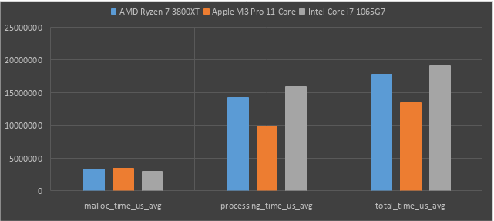
Benchmark
Performance
+32%
+41%
+61%
+44%
+14%
+18%
Performance in microseconds (averaged over 10 test runs)
*lower is better

Slide 13
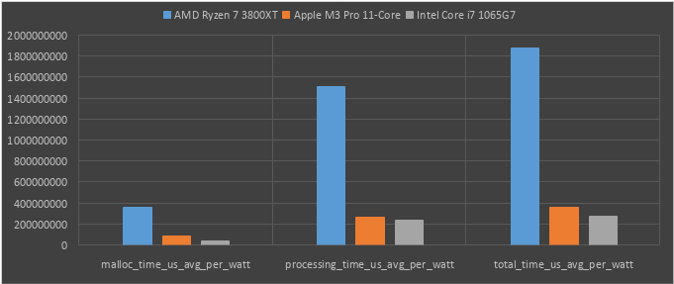
Benchmark
Performance per watt
+656%
+628%
+801%
+112%
+128%
+212%
Performance per watt in microseconds (averaged over 10 test runs)
*lower is better

Slide 14
Outlook
Work in progress
(Apple M3 Pro NPU)
Multithreading
Implemented, but needs a lot of testing
SIMD
Arm Neon
Quantization
SSE vs. AVX2 vs. AVX-512
ICX vs. GCC
Both finally work, but Intel oneAPI needs testing
CUDA tuning
NVCC finally works

